Slide 1
Digital Design and Synthesis
COEN 6501

Slide 2
Lecture_1
In this lecture we will review:
The Digital Design process
Introduce and review Adders
The Carry Ripple Through Adder
The Carry Look Ahead Adder

Slide 3
System Design Description
Systems are described in terms of three domains:
Behavioural domain
Structural domain
Physical domain

Slide 4
Logic Synthesis
Behavioural
Structural
Physical
Synthesis
Physical

Slide 5
Logic synthesis
System
Structural
Behavioural
Algorithmic
Processor
Systems
Micro architecture
Algorithms
Hardware modules
Logic
Register transfer
ALU, registers
Logic Equations
Circuit
Gates, F/Fs
Transfer function
Transistors
Physical
synthesis
Rectangles
Cells
Macro-cells
Modules
Chips, boards…
Physical

Slide 6
Expected power savings in logic synthesis at various levels of design flow
Optimization Levels
Level
Transformation
Expected Power Saving
Algorithmic
Algorithm selection
Orders of magnitude
Behavioural
Concurrency
Several times
Register Transfer Level
Structural transformations
~10 - 15%
Clock control
~10 - 90%
Data/signal encoding
~20%
Technology independent
Extraction/decomposition
~15%
Technology dependant
Technology mapping
~20%
Gate sizing
~20%
Layout
Placement
20%

Slide 7
System Specification
Design Process:
It starts with behavioural
description, decomposing
the high level of constructs
into more precise functional
units, then mapping these
units into physical elements.
Architectural Design
(behavioural)
Analysis
Design Implementation
(structural)
Analysis
Design Implementation
(Physical)
Analysis

Slide 8
Design Strategies
Hierarchy
  A repeated process of dividing large modules into smaller sub-modules until the complexity of sub-modules are at an appropriately comprehensible level of detail.
  Parallel hierarchy is implemented in all domains.

Slide 9
A Structured Design
Regularity
  Divide the hierarchy in to similar building blocks whenever possible.
  Some programmability could be added to achieve regularity.
Modularity
  Well defined behavioural, structural and physical interface.
  Helps: divide tasks into well defined modules, design integration, aids in team design.
Locality
  Internals of the modules are unimportant to any exterior interface.

Slide 10
System Design Methodology
Market windows
System features & requirements
Standards
Market Analysis
Functional
Electrical
Mechanical
Environmental
System Specifications
Strategies
Modelling
Verification
System Architecture
Dictated by complexity, I/O pins, off-the-
shelf components, special requirements
Partitioning guidelines
Partitioning approaches: vertical,
horizontal, functional, performance
System Partitioning

Slide 11
Strategies, chip testing, board
testing
Testability features
Penalties
Testability
Dictated by: speed, power
dissipation, driving capability,
cost, lead time
Technology Selection
Logic design/synthesis
Optimization
Verification
Detailed Design
Off-the-shelf ICs
Application Specific ICs
Implementation

Slide 12
Decide on packaging technical components
Design/manufacture
Components
Electrical/mechanical assembly
Mechanical assembly & components sales
Assembly
Functional
DC test
AC test
Burn-in
Testing
Technical documents
H/W & S/W & mechanical
User manual
Test document
Documentation
Production

Slide 13
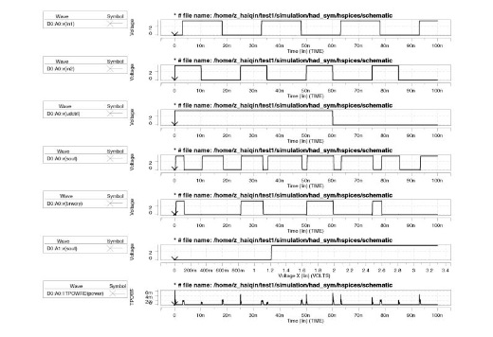
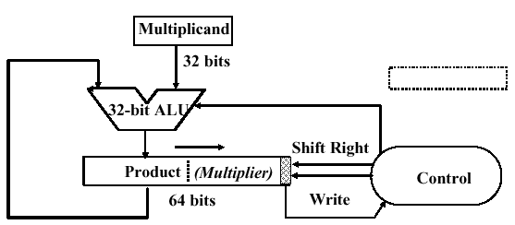
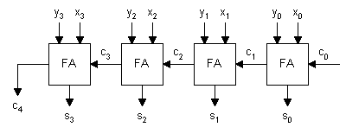
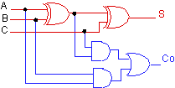
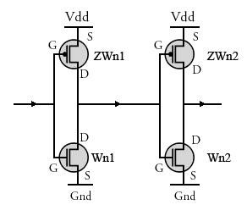
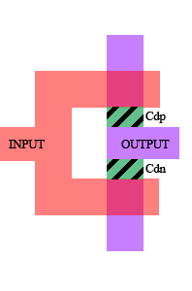
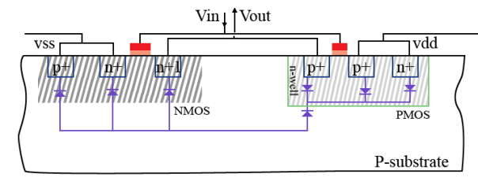
Verify at every step
MEMORY
CPU
Functional
Structural
Logic
Circuit
Device
Layout

Slide 14
IC Design Methodology
Requirement specification
  most important function which impacts the ultimate success of an IC relates to how firm and clear the device specifications are.
  Device specification may be updated throughout the design cycle.
  Main items in the specifications are:
    functional intent: brief description of the device, the technology and the task it performs.
    Packaging specification
      device port number
      package type, dimension, material

Slide 15
Functional Description
  Functional description
    high-level block diagram: all major blocks including intra block connections and connections to pin-outs indicating direction and signal flow.
    Intra block signal function: description of how blocks interact with each other supported with timing diagram where necessary.
    Internal block description of internal operation of each block. Where necessary, the following to be included: timing diagram, state diagram, truth table.

Slide 16
Specifications
  I/O specifications
    pin-out diagram
    I/O functional description
    loading
    ESD requirements
    latch-up protection
  D.C. specifications
    absolute maximum ratings for: supply voltage, pin voltages
    main parameters: VIL and VIH for each input, VOL and VOH for each output, input loading, output drive, leakage current for tri-state operation, quiescent current, power-down current (if applicable)

Slide 17
Specification, continued
  AC specifications
    inputs: set-up and hold times, rise and fall times
    outputs: propagation delays, rise and fall times, relative timing
    critical thinking
  Environmental requirements
    operating temperature, storage temperature, humidity condition (if applicable)
  Testing

Slide 18
Device Specification
Functional intent: briefly describe the device, the technology, and the circuits it will replace as well as the task it will perform.
Design concept
    pin-out diagram: describe the device using a block diagram of the external view of the chip - basically, a box with all the I/O pins labelled and numbered
    I/O description: use a chart to define the I/O signals shown in the pin-out diagram

Slide 19
Example:

Slide 20
Functional Specification
    internal block diagram: draw blocks for major functions, show all connections including: connection to all pin-outs, connections between blocks, and direction of signal flow
    Inter-block signal function: describe how the blocks interact with each other and support this with timing diagrams where necessary
    internal block description: describe the internal operation of each block. When necessary, include: timing diagrams, state diagrams, and truth table
  Logic description: circuit schematic or logic
diagram using standard cell library components
Package description: device port number, package
type, dimensions, materials

Slide 21
Operating characteristics
Absolute maximum stress ratings.
Example:

Slide 22
Requirements
  Operating power and environmental requirement:
    power supply voltage
    operating supply current (specify conditions, e.g., power up, power down, frequency, output conditions)
    storage temperature
    operating temperature
    humidity conditions (if applicable)

Slide 23
Input characteristics. Example chart:
(V reference is VSS = 0, temperature range is 0oC to 70oC)

Slide 24
Output Interface Characteristics
Example chart: (VSS = 0, T range 0oC to 70oC

Slide 25
AC description
Timing diagram: include well-labelled signal drawings of all significant input and output relationships, rise and fall times, data set-up and hold times. Indicate the voltage range over which timing must be guaranteed
Definitions:
VIH
Cout
VIL
Set-up
hold
VIH
input
VIL
output
hold

Slide 26
Example: timing diagram and chart
t16
RXCK
t19
t20
RXFRM
t22
t18
t17
RXIN
t21

Slide 27
Specs (continued)

Slide 28
Critical Path
Signal paths with ‘tight’ timings (if applicable)
potential ‘race’ conditions (if applicable)
any set of paths with the same source and destination such as a clock signal and its complement (if applicable)

Slide 29
Test Description
Test strategy: written description of functions to be tested. This section is a guide for determining and explaining simulation patterns
simulation input/output patterns: timing diagrams which include stimulus to be applied to input pins and the expected response on the output pins

Slide 30
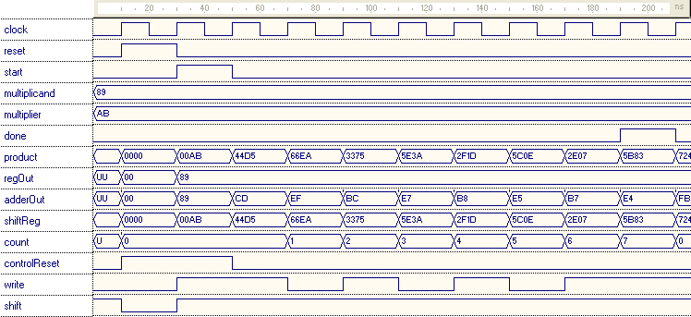
Example :
Multiplicand = 10001001₂ = 89₁₆
Multiplier = 10101011₂ = AB₁₆
Expected Result = 101101110000011₂ =5B83₁₆

Slide 31
System Level Design
Top down approach
Using behavioural constructs, top level architecture is defined
Design validation is technology independent
Use HDL to model the design (e.g., VHDL and Verilog)
RTL is efficient for describing data flow

Slide 32
System Level design (Continued)
Timing verification is difficult unless structure logic is defined
VHDL representation can be changed into structural logic through - manual design, design synthesis: automated process which involves the conversion of VHDL/RTL into a set of registers and combinational circuits

Slide 33
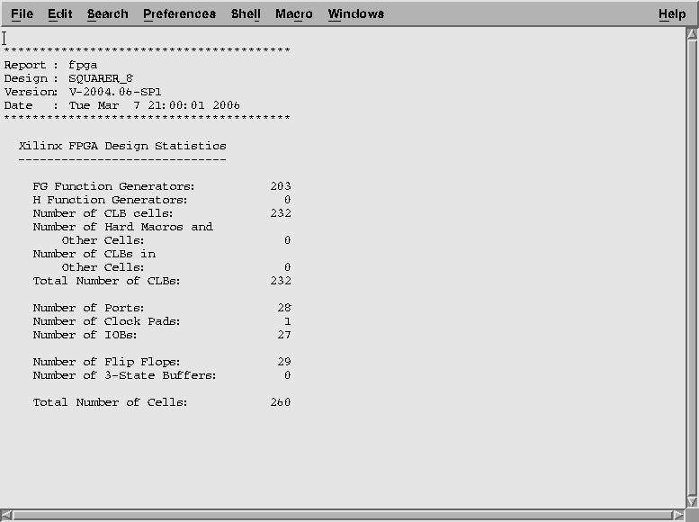
Synthesis report

Slide 34
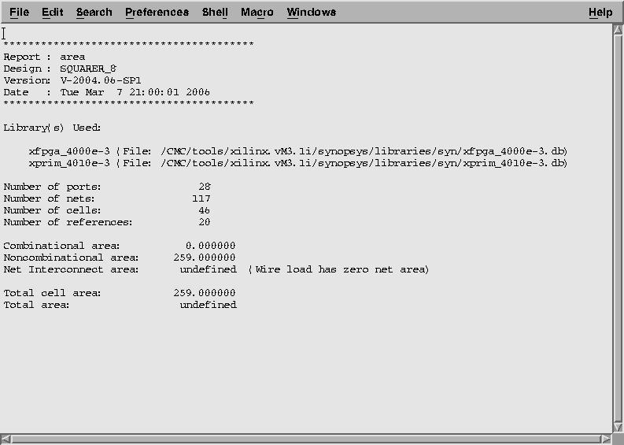
Area report after Synthesis

Slide 35
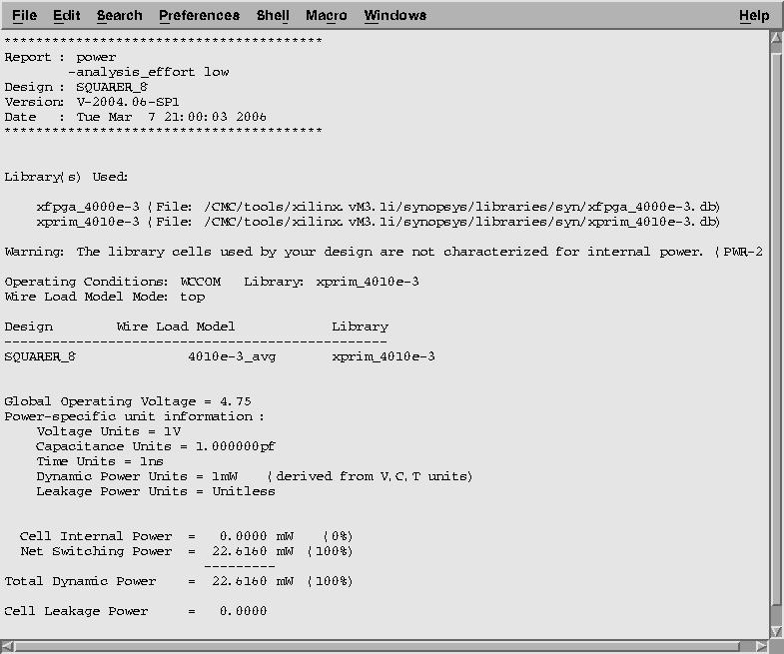
Power report after Synthesis

Slide 36
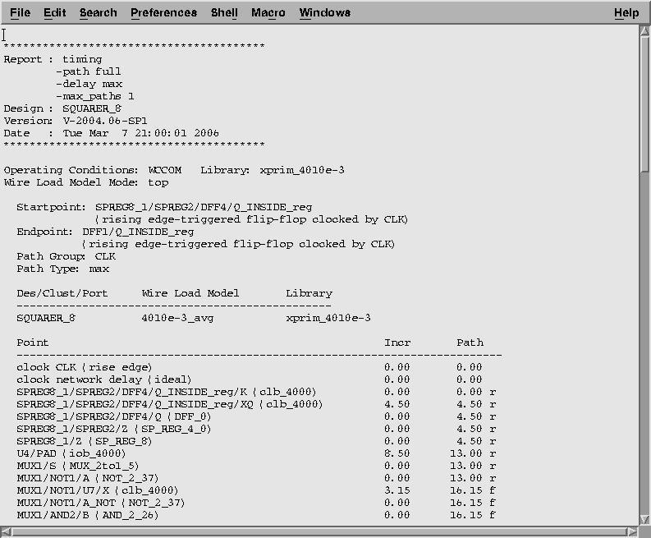
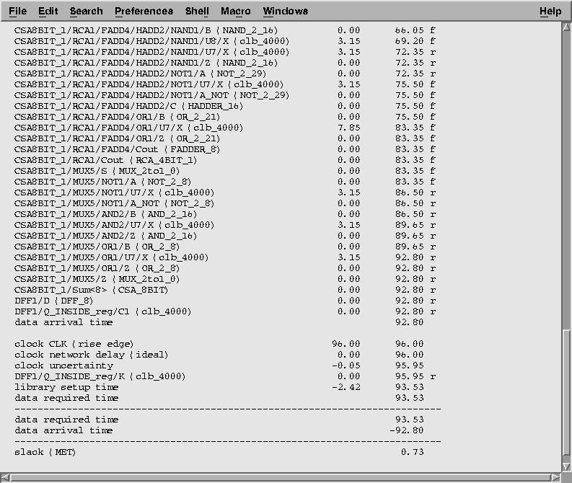
Timing Report After Synthesis

Slide 37
AIMs
What the CUSTOMER wants
High Quality
Low Cost
Small Size/Weight
What the EMPLYER wants
Design the:
Best
Cheapest
In shortest time
Follow the Spec or better.
What you CHIP DESIGNER should do:
Design a chip with:
High speed
Small area
Low power
Testable and reliable
Delivered in a short time

Slide 38
Logic Design
Evaluation of library constructs (basic & macro) function, timing, area
Logic minimization
NAND/NOR transformation
Buffering
Fan-out reduction
Fan-in reduction

Slide 39
Logic Level design (Continued)
Critical timing
Priority routing
I/O compatibility
Logic optimization
Cost function: area, speed, power, or a combination

Slide 40
Logic Simulation
Simulation is the process of exercising a theoretical model of the design as a function of time for some applied input sequence
Logic simulation is to aid in verification of a digital system

Slide 41
Logic Simulation (Continued)
Components
  models: functional, timing
  connectivity: a description of how the basic components are connected together
  stimulus: 1’s and 0’s that are applied at specific times to the primary inputs of the design
  simulation control
States: basic (0, 1, X), strength could be combined with basic; strong (S), resistive (R), high impedance (Z), indeterminate (I)

Slide 42
Simulation model
- logical
***************************************************
** Library: ACME
** Technology: 2u CMOS
** Part: fdrc
**
** Description: D flip-flop with rising edge, async. Clear
***************************************************
model fdrc: table
input d, rn;
edge_sense input cp;
output q, qn;

Slide 43
State_table
rn, cp, d, q :: q, qn;
***** ------------------------------------------------------------
0, (??), ?, ? :: 0, 1,
1, (01), ?, ? :: (d), !(d);
1, (?0), ?, ? :: N, !(q);
1, (1?), ?, ? :: N, !(q);
end (fdrc: table);

Slide 44
Timing Verification
Process of making accurate delay prediction and to detect timing violation in the design. These violations include set-up time, hold time, races and spikes.
Delay through the circuit is a function of:
  intrinsic delay
  number of loads connected to each net
  temperature
  voltage
  process variation, layout
Typically, best and worst case scenarios should be considered.

Slide 45
Simulator uses a set of equations to calculate exact delays
Fan-out
  td = t(int) + K*L
  t(int) = intrinsic delay
  K = drive factor
  L = sum of equivalent loads

Slide 46
Timing Verification (Continued)
temperature td = td/FT FT = (T2/T1) -M
voltage t’d = td/[VDDr(1 + 0.0f)]
process t’d = td(1 + 0.01Fp), Fp = = processing variation factor
layout information is normally supplied in two forms:
  pre-layout estimation
  post-layout: back annotation

Slide 47
Timing
hazards
  spikes: inertial and transport delays
  set-up time/hold time/minimum pulse width
inertial
tPLH = 2
tPHL = 1
transport

Slide 48
Timing
Critical path analysis
  detection of timing violation for data path structure
  the process is simply adding up path delays and compute the result with the period of the clock at the destination (F/F)
  path analysis is not simulation and does not utilize information about the functionality of the device
  look for two parameters
    hold slack = clock period - hold path time
    set up slack = clock period - set up path time
    slack >= 0
    paths are chosen to provide the least amount of available set up or hold times

Slide 49
Structural layout synthesis
Floor planning
  it is the exercise of arranging blocks of layout within a chip to minimize area or to maximize speed
  floor plan editors provide graphical feedback about the size and placement of modules (without showing details), also the connectivity information between the modules in the form rat’s-not
  floor planning could be done manually, or automatically with manual intervention
  factors influencing floor planning (core & I/Os)

Slide 50
C
A
B
D

Slide 51
Placement and routing
Placement: is the task of placing modules adjacent to each other to minimize area or cycle time
two algorithms: min-cut, simulated annealing
routing: a router takes a module placement and a list of connections, connects the modules with wires
types of routers: channel, switch box, maze

Slide 52
inv
inv
reg
nd2
nd2
nd3
Channel route
reg
inv
nd2
nd3
inv
inv
inv
Channel route
nd2
nd2
nd3
nd2
nd2
inv
nd2

Slide 53
Layout
Other layout tools
  synthesis
  compaction
Layout verification
  design rule checking
  layout extraction
  layout vs. schematic
Back annotation of post layout simulation

Slide 54
Testing
  to verify the correct operation of the device by exercising it by a set of test patterns, and then to check the output patterns to see whether they are identical to the ones predicted by the simulator
  tester also verifies DC and AC parameters on the pins of the device
o/p
i/p
from
simulator
X 0 1 1
0 1 0 1
Z 1 1 1
: : : :
0 1
1 0
0 1
: :
DUT
comparator

Slide 55
Timing Analysis
  Tester operates in a periodic fashion
  input signals charge states at the beginning of the test period
  output signals are strobed at the end of the period to determine whether the measured values matches the simulated values..
Test
cycle
T0
T0
T0
i/p
o/p
strobe

Slide 56
Types of Testing
Functional (mostly at lower speeds)
  static
  dynamic (refresh if required)
DC test
  continuity
  leakage, power consumption
  high/low voltage levels, drive capability
AC test
  rise/fall times, propagation delays
  set-up and hold times, access times

Slide 57
COEN 7741
Advance Comp. Arch
Functional unit
COEN 7501
Formal Verification
Functional unit
Functional unit
Processor
ENCS 6521
Design for Testability
register
register
ELEC 6501
COEN 6531
ASIC Synthesis
register
ENCS 6511
LOGIC
CIRCUIT
ELEC 6231
LAYOUT
ELEC 6241
FABRICATION

Slide 58
Binary Arithmetic

Slide 61
Example: design an addition overflow circuit, in accordance with the following specification:
When the operation is addition and both addend and augend are +ve, overflow is indicated by a carry from the most significant digit (MSD)
when the operation is addition and both addend and augend are -ve, overflow is indicated by the absence of carry from the MSD
when the operation is subtraction and the minuend is +ve and the subtrahend -ve, overflow is indicated by a carry from the MSD
when the operation is subtraction and the minuend is -ve and subtrahend is +ve, overflow is indicated by absence of a carry from the MSD

Slide 62
THE END

